Slide 1
Managing an Alliance

Slide 2
Managing an Alliance

Slide 3
Draw up a formal agreement:
Who does what for what return

Slide 4
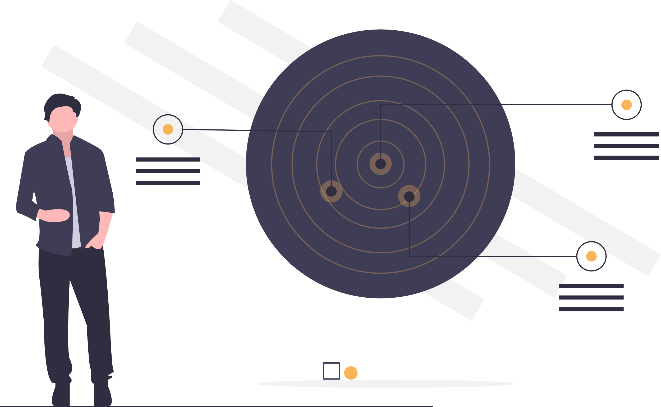
Agree Targets

Slide 5
Record Work Activity;
Measure progress against targets

Slide 6
Agree a timetable for regular communication

Slide 7
Mutually trusted third party to act as mentor/buddy/honest broker

